Slide 1
Welcome to the First Meeting of the Year!
AMWHO Meeting

Slide 2
EXEC.
BOARD
Introductions!

Slide 3
AMWHO MISSION STATEMENT
Professional Networking
Conference & Debate
Experience

Slide 4
5 Reasons to join amwho:
1) Build connections and network with influential people
2) Improve upon public speaking skills that are essential in every field
3) Learn about global health events that affect current policies & daily life.
4)Expand your resume by attending conferences & events.
5) Applicable to various fields such as medicine, law, public health, business, international affairs, etc.

Slide 5
Structure of Meetings:
1) Interactive Activity
2) Conference Content
3) Experiential Learning

Slide 6
1) Interactive Activity:
"Getting to Know You"
Find someone around the room who you do not already know.
Introduce yourself by stating:
1) Your Name
2) Your Major
3) Your Year
4) & One Interesting Fact about Yourself
Once you have both introduced yourself,
assume the identity of the person you just met,
and then go around the room introducing yourself as them!
(Will be demonstrated by Exec. )

Slide 7
SOCIAL
MEDIA
ASSETS
FACEBOOK
@AMWHO.UGA
GROUPME
QR Code and Link on Next Page
INSTAGRAM
@amwhouga

Slide 8
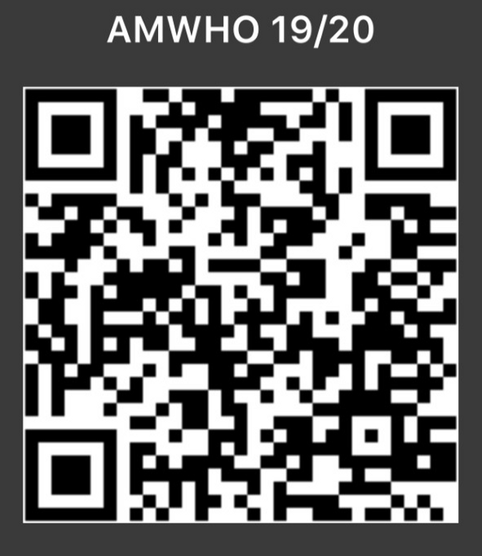
GROUPME
SOCIAL
MEDIA
ASSETS
Groupme "AMWHO 19/20"

Slide 10
MEETING TIMES:
Save. The.
DATES!
October 9th and November 6th
NATTY'S BBY!
April 3rd -> April 5th
UGA AMWHO CONFERENCE
Sometime in January!

